Slide 1


AUTOMATED ALGORITHMIC ACCIDENT PREVENTION SYSTEM
GUIDE : SUBMITTED BY:
Dr. S. BALAJI.,(Ph.D.), GUNASEELAN k (211417104072)
Head of assistant professor HARIHARAN B (211417104075)
department of cse SUDHARSAN K (211417104272)
panimalar engineering college

Slide 2
ABSTRACT
The main impact of this project is to minimize the number of accidents. Now-a-days, more number of accidents occurs during the time of Mist season and also the driver cannot able to predict the amount of brake applied by the before vehicle. So our proposed project will rectify these problems. The UltraSonic Sensor is used to gather the information of the Distance between the before vehicle or any obstacles and display the distance to the Driver using the LCD Monitor which is placed in front of Driver. This technique is useful for the Vehicle Drivers during Mist Season to analyze the distance of vehicles and prevent themselves from an Accident.

Slide 3




. The LCD Display should also be placed at the backside of Vehicle which displays distance between the current vehicle and previous vehicle. This displays about an distance information to the next upcoming vehicle. So that the drivers can able to predict and slow down the vehicles without putting any rash brakes. So this concept will be useful during all the Season to prevent the Accidents by using Rash Brakes.

Slide 4
Our Proposed project also useful to convey the message to the Parents when accident has occurred. This can be achieved by using the Crash Sensor, GPS Module, GSM Module. The Crash Sensor is used to pass the information to the GPS Module when an accident has occurred. The GPS Module will get an information about the Current Location where an accident had occurred and pass information to the GSM Module. The GSM Module will send the message with the desired Location to the registered Mobile Number. Thus the People can be saved by admitting in the Hospital within time.

Slide 5
TECHNOLOGY STACK
Software:
Arduino Software
Hardware:
Arduino UNO Board
Ultrasonic Sensor, Crash Sensor
Global Positioning System (GPS)
Global System for Mobile Communication (GSM Module)
Liquid Crystal Display (LCD)

Slide 6
MODULES
ULTRASONIC SENSOR
This sensor is useful to retrieve the information about the distance between current vehicle and the previous vehicle or any obstacles.
CRASH SENSOR
This sensor is useful to send an information to perform specific task when an accident occurs.
LCD DISPLAY MONITOR
It is useful to display the data analyzed by the Sensor.

Slide 7
GPS MODULE
This module is useful to retrieve an information about the Current Location (Latitude and Longitude) from an environment.
GSM MODULE
This module is useful to send the message to the Registered number (which should be configure in GSM Module)

Slide 8
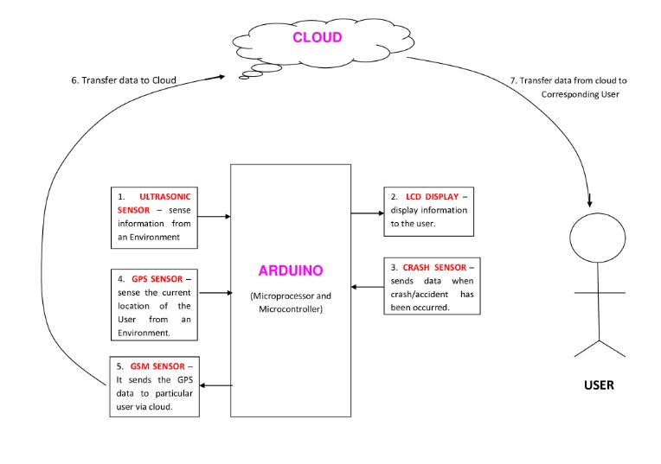
SYSTEM ARCHITECTURE

Slide 9
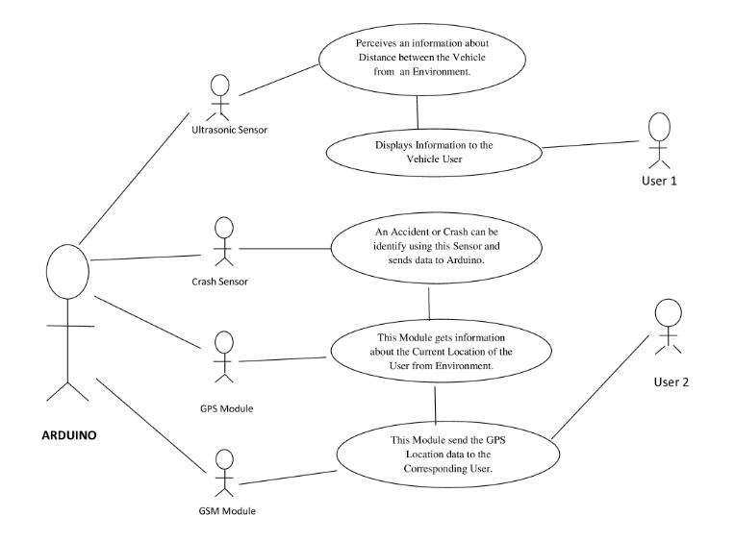
UML DIAGRAM

Slide 10
LITERATURE SURVEY
IOT Based Implementation of Vehicle Monitoring:
Monitoring of vehicle safety while driving from adjacent vehicles by using sensors to find if any vehicle comes very much close to the user’s vehicle and thereby providing safety by permeating the user.

Slide 11
OUTCOMES / BENEFITS
This device helps the drivers to analyze the accidents going to happen and prevent themselves. Our Proposed System gives prior information about the Previous vehicle or any obstacles. Thus the drivers can able to manage the situation and prevent the accidents. Suppose incase any accident occurred without the knowledge of drivers, then our system will generate and transmit message to the registered number. Our Scope is to reduce the number of accidents and prevent people if any accidents occurs.

Slide 12

Thank You!

